Slide 1

Ericom Software
Secure Web & Application Access
Ericom Shield Overview Briefing
Click to Launch
Notes:
This presentation is designed to be used in a first meeting with the customer regarding shield
It quickly introduces the breath of Ericom’s portfolio and then moves into a focus discussion on shield

Slide 2







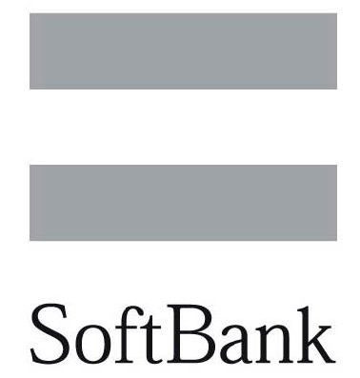





Company Snapshot
Ericom is a provider of secure web and application access products
We count among our clients:
@ 70 employees
Primarily based in the Greater NYC area, Israel, and the UK
>5,000
B2B clients in 45 countries
Ericom Software Proprietary Information

Slide 3

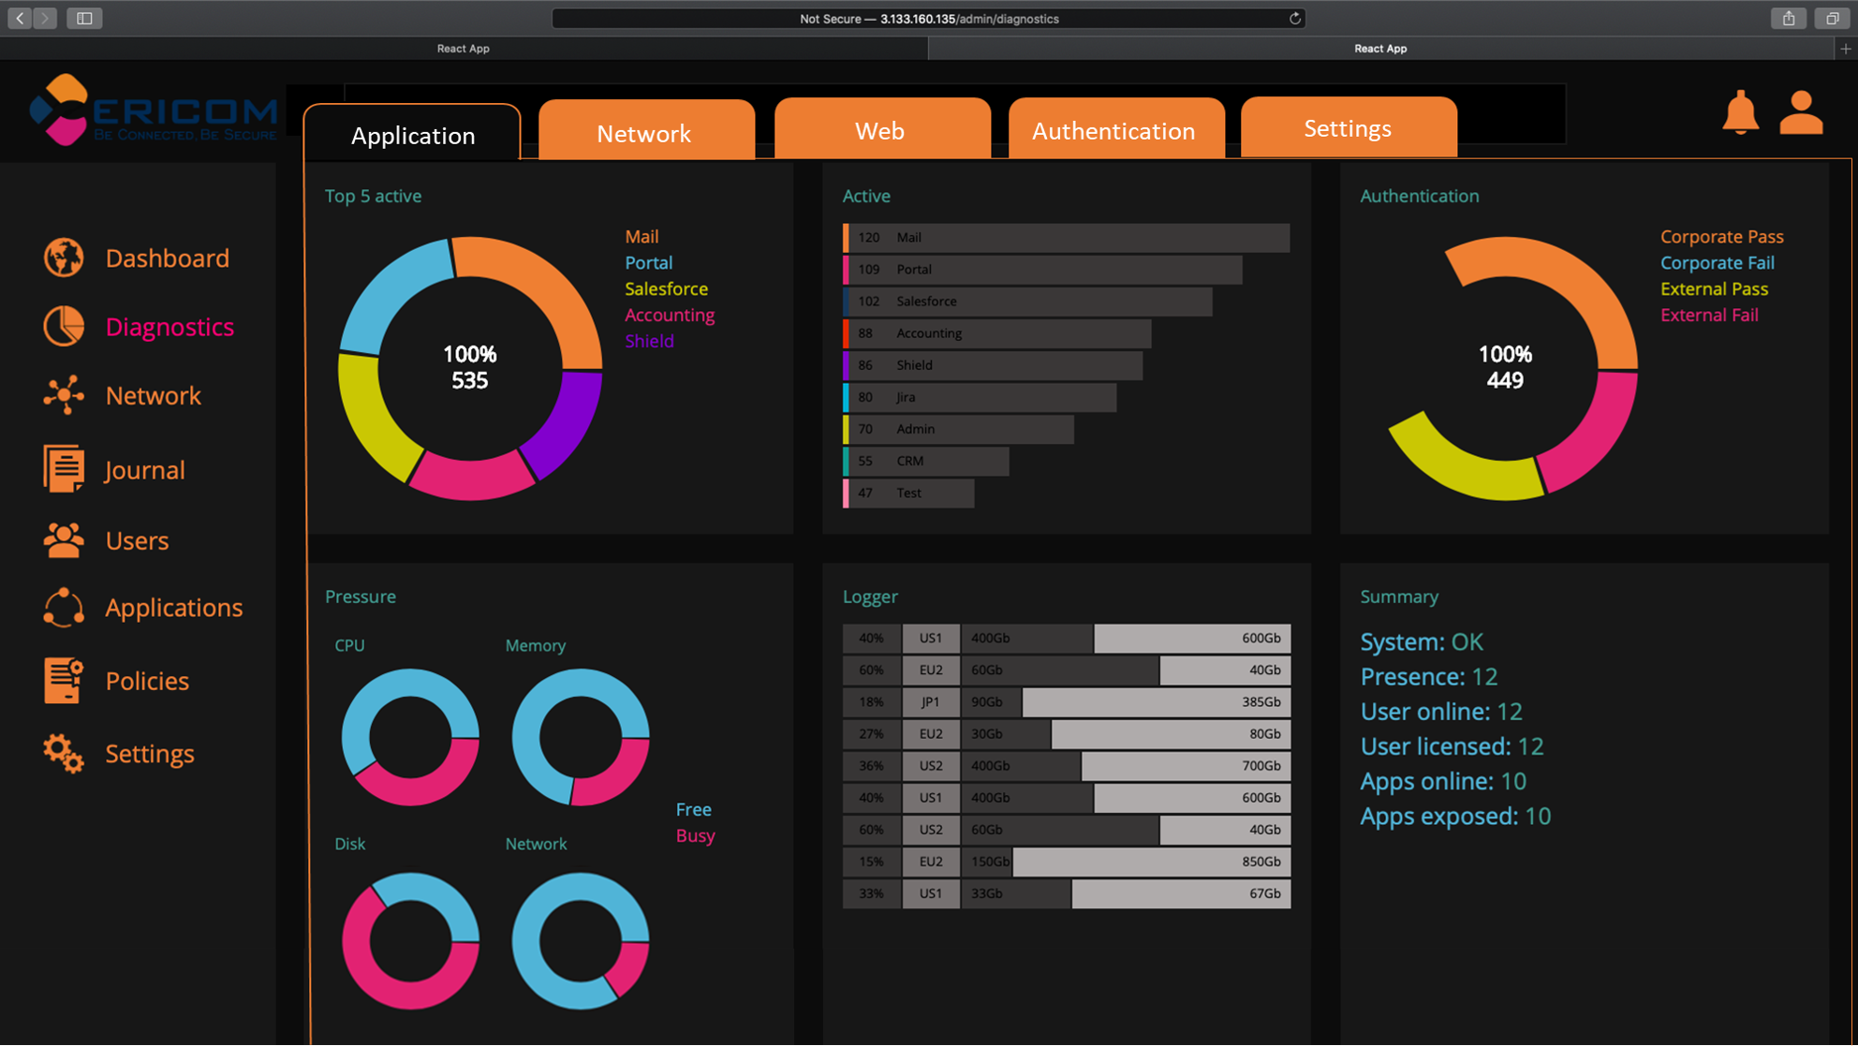


Ericom Solution Overview
Secure Application Access
Solutions for securely connecting users with corporate applications
and resources
Secure Web Access
Solutions that allow enterprise users
to securely browse the web and access
e-mail
Secure Digital Transformation Initiatives
Reduce IT
Complexity and Cost
Improve
User Productivity
Notes:
Ericom is a Secure Access company
Portfolio of solutions covering secure web access and secure application access
Supports enterprise’s Digital Transformation Initiatives, Cost and Complexity reduction efforts, and programs to improve User Productivity

Slide 4
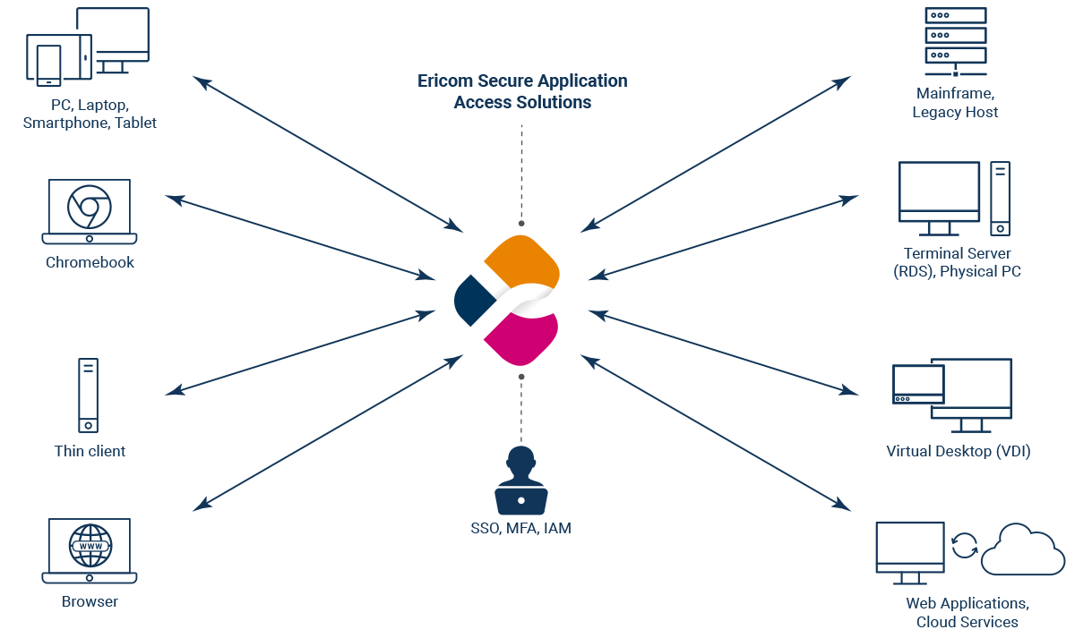

Secure Application Access
SECURE ACCESS TO WINDOWS APPLICATIONS AND DESKTOPS, LINUX APPS AND LEGACY HOST SYSTEMS
Ericom Connect
Secure remote app and desktop connection broker
Browser-based access with no client-side installation required
Ericom PowerTerm
Robust terminal emulation host access solution
Supports 35+ terminal emulation types
Notes:
Ericom’s Secure Application Access solutions include Connect and Powerterm.
These software solutions enable remote access to Windows Apps and Desktops, Linux Apps and Legacy Host Systems

Slide 5
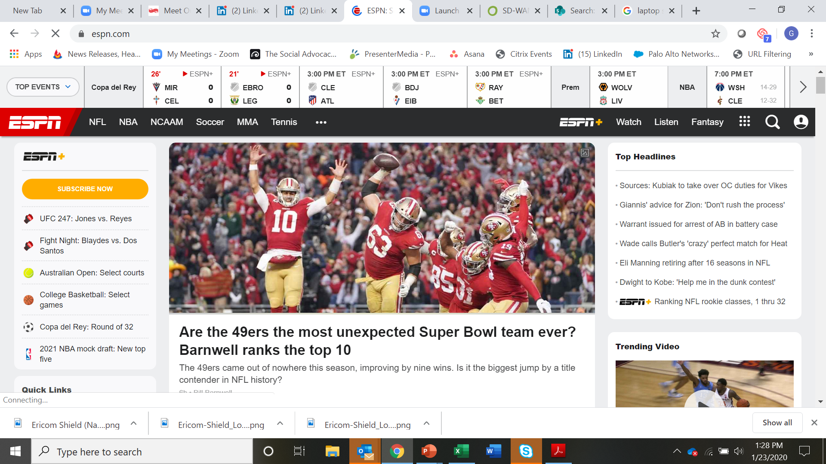






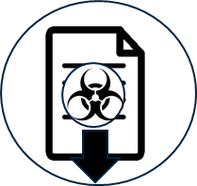
Secure Web Access
ZERO TRUST BROWSER ISOLATION SERVICE
JAVA
HTML5
JS
MP4
Ericom Shield
Neutralizes web-based malware and phishing attacks using
Remote Browser Isolation (RBI) technology
CSS
Fonts
Pic
Prevents Malware
Blocks Phishing Attacks
Stops Malicious Downloads
Notes:
Ericom’s Secure Web Access solution is Ericom Shield Remote Browser Isolation
Renders web content in a remote isolated container to prevent 100% of malware from impacting endpoints
It prevents web-base malware, web mail phishing attacks, and malware in content downloads from the web

